Slide 1
Building Healthy Recovery Communities

Slide 2
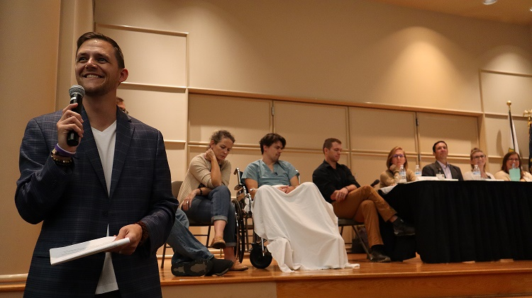
Brandon George
Executive Director, Indiana Addiction Issues Coalition

Slide 3
Is addiction REALLY a public health issue?
While we acknowledge that it is a public health issue, it has not historically been treated as such.

Slide 4
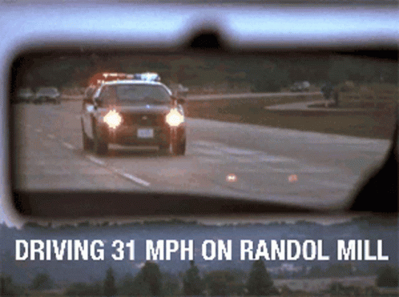

Slide 5
Substance use disorder is a chronic disease.
But our treatment modalities are not reflective of this.

Slide 7
What is our goal?

Slide 8
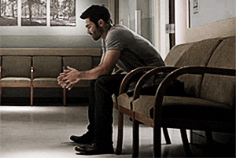
Treatment?

Slide 9
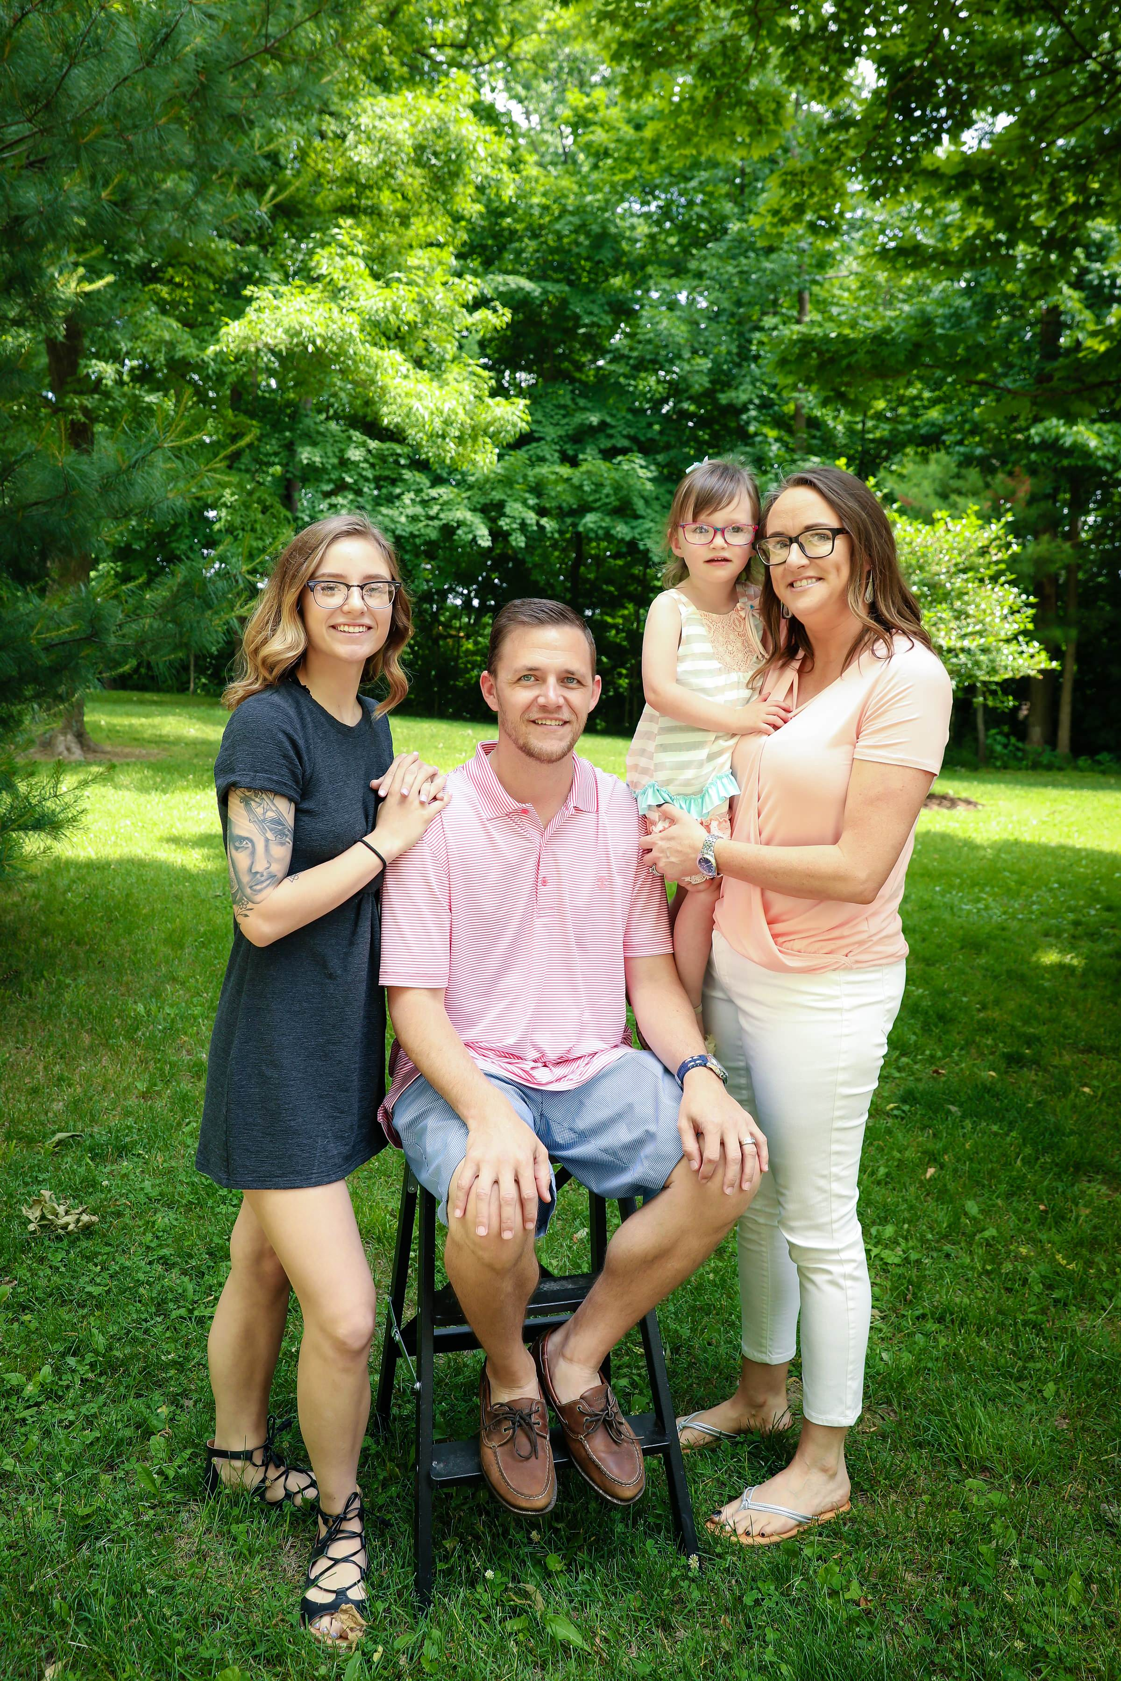
Recovery!

Slide 10
Four Dimensions of Recovery

Slide 11
Health
Home
Community
Purpose

Slide 12
Health
Home
Community
Purpose

Slide 13
Health
Home
Community
Purpose

Slide 14
Health
Home
Community
Purpose

Slide 15
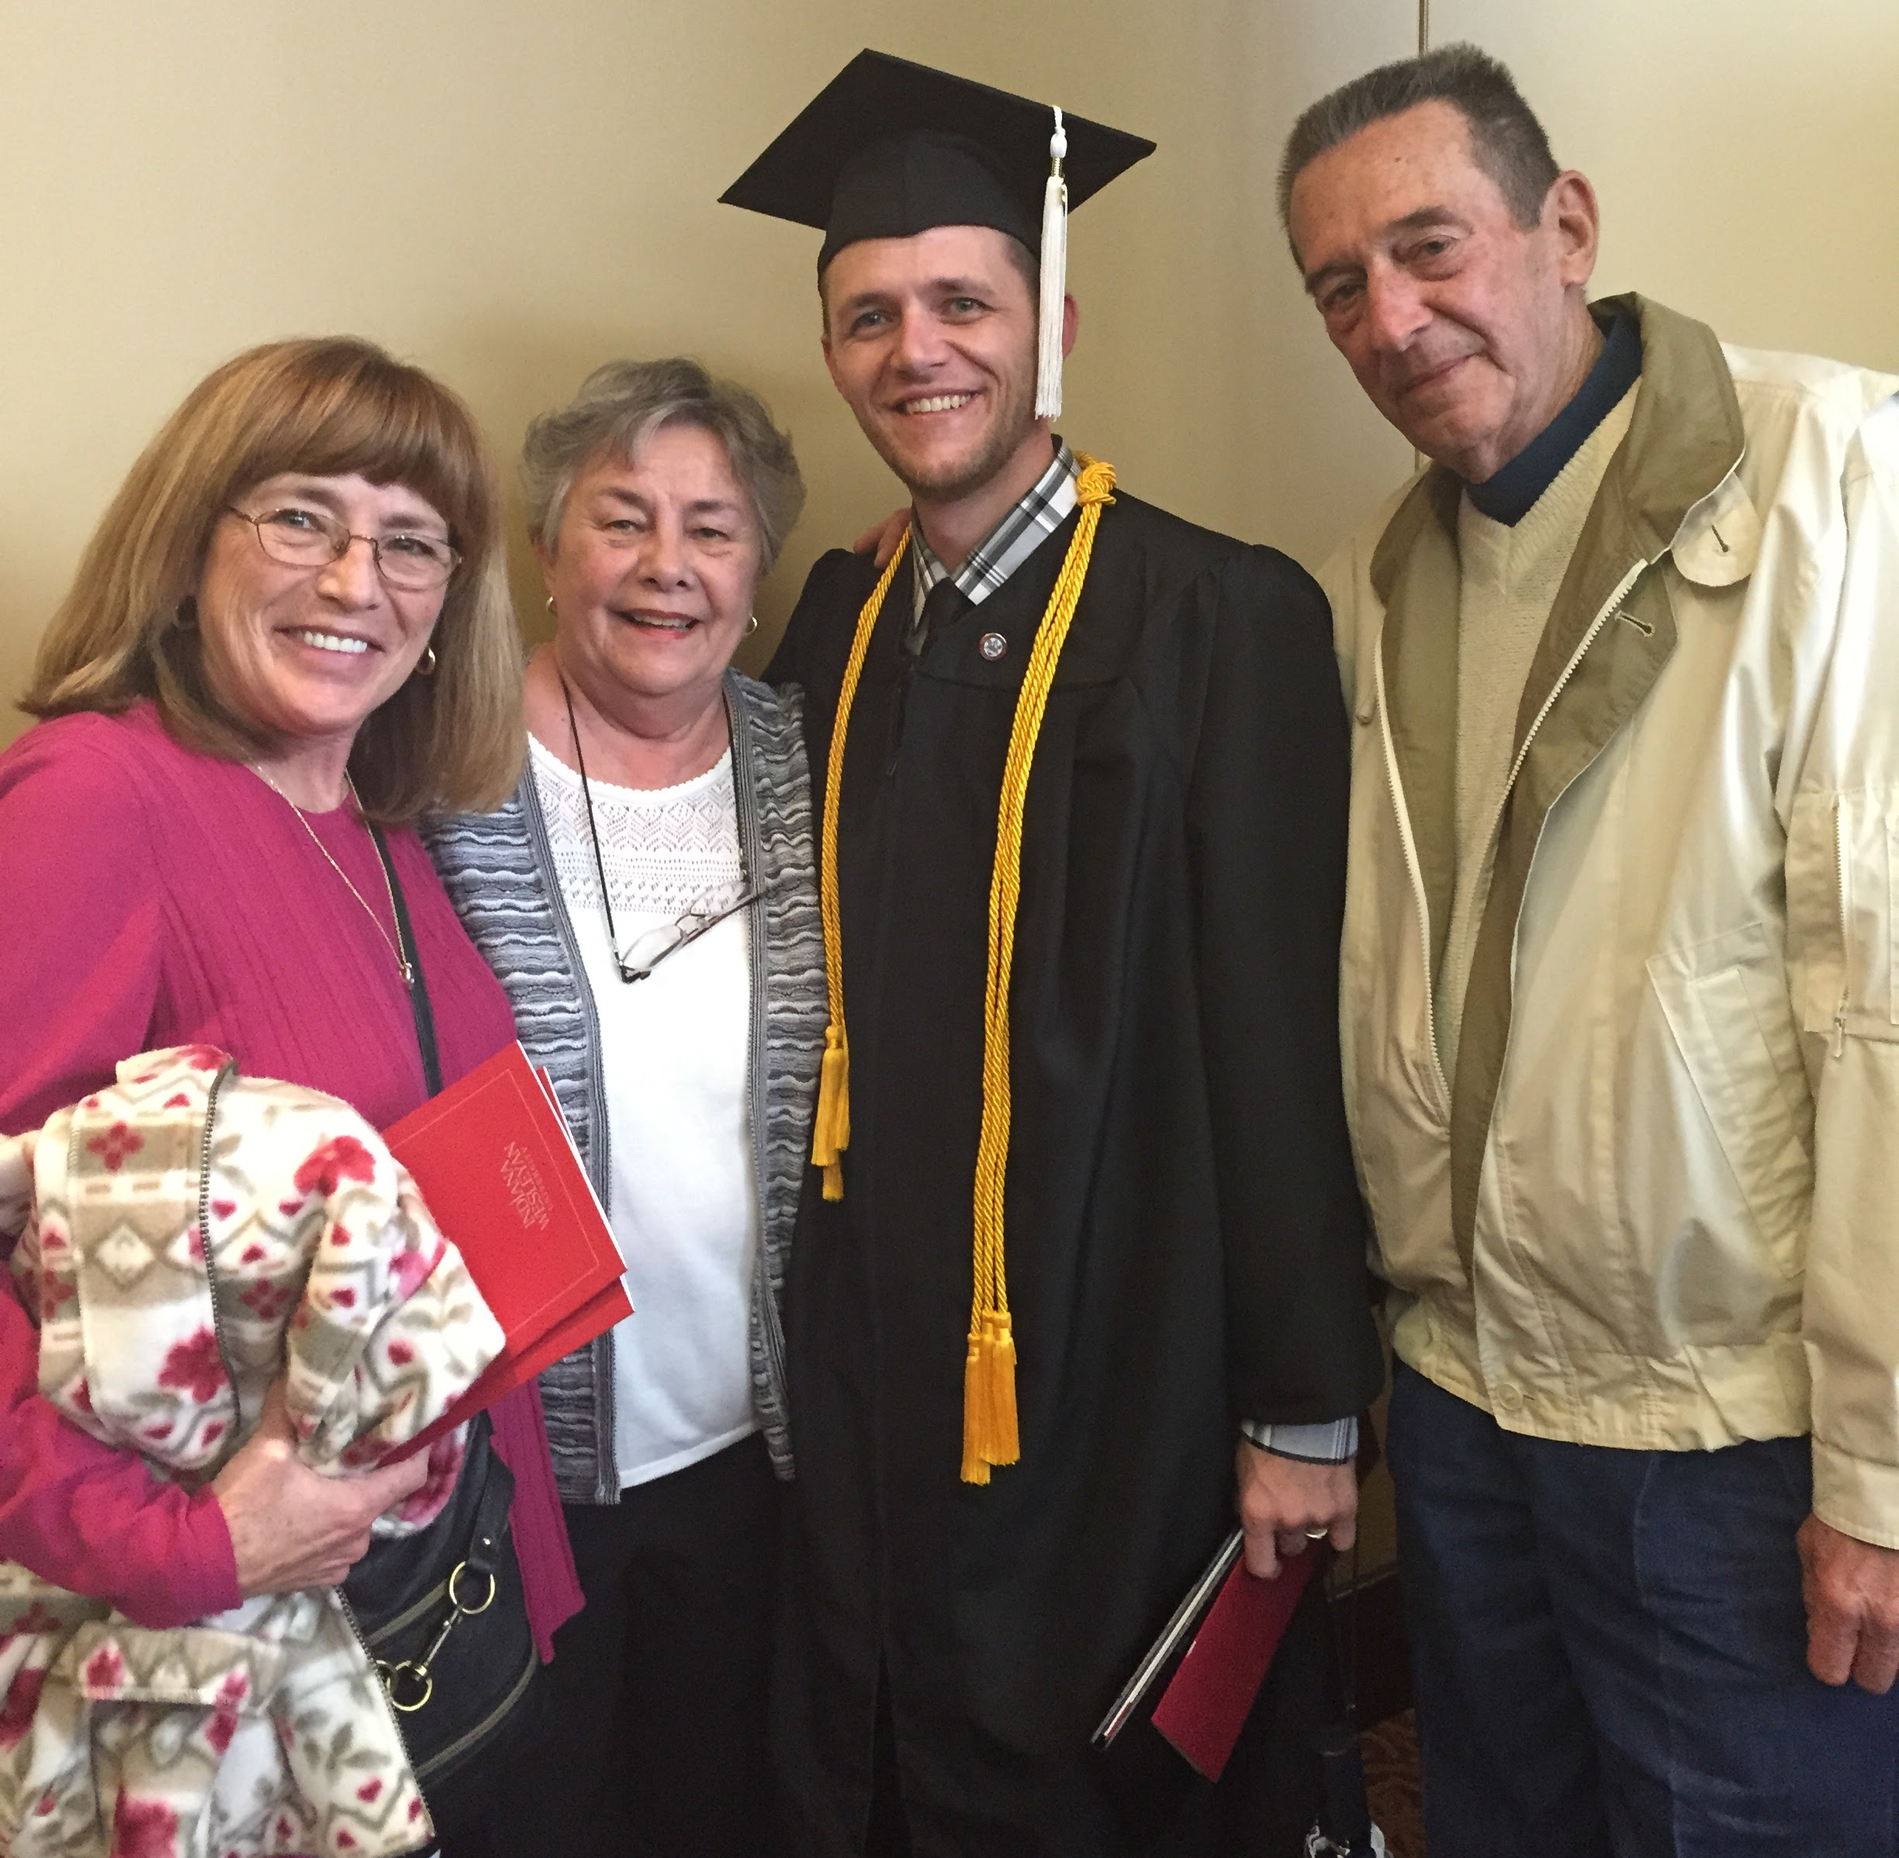

Slide 16
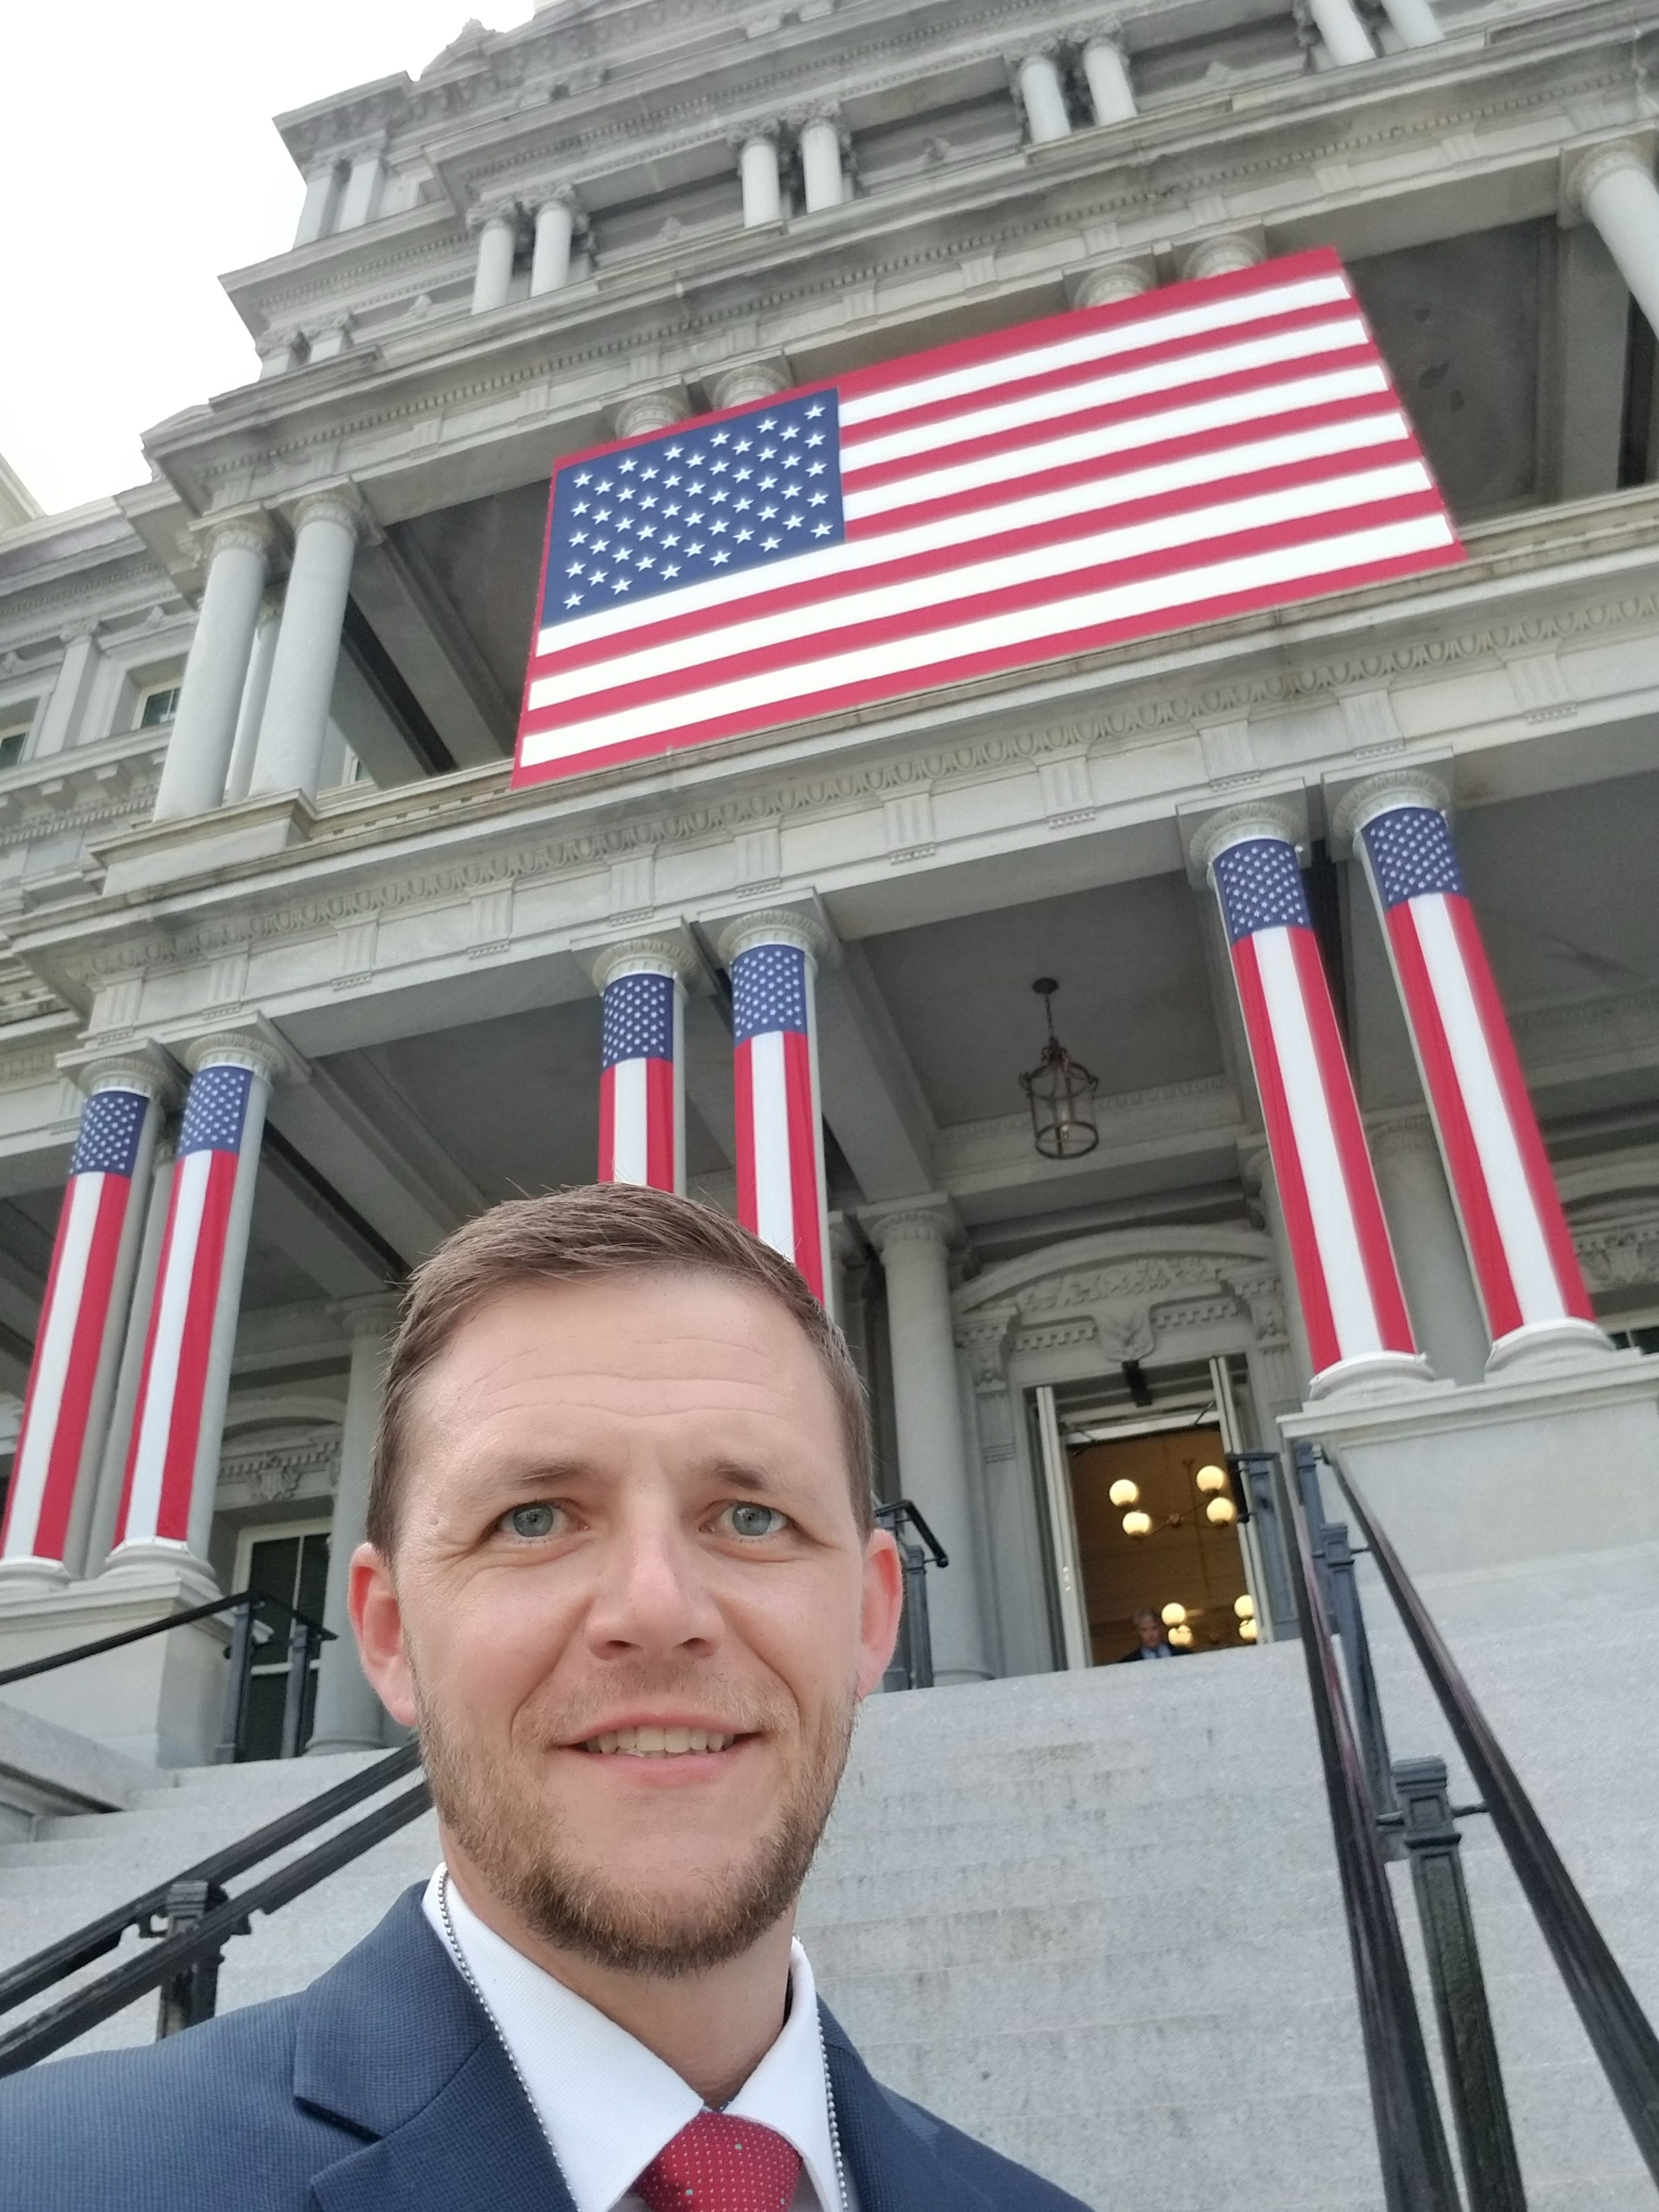
White House

Slide 17
Boone County Jail Program

Slide 18
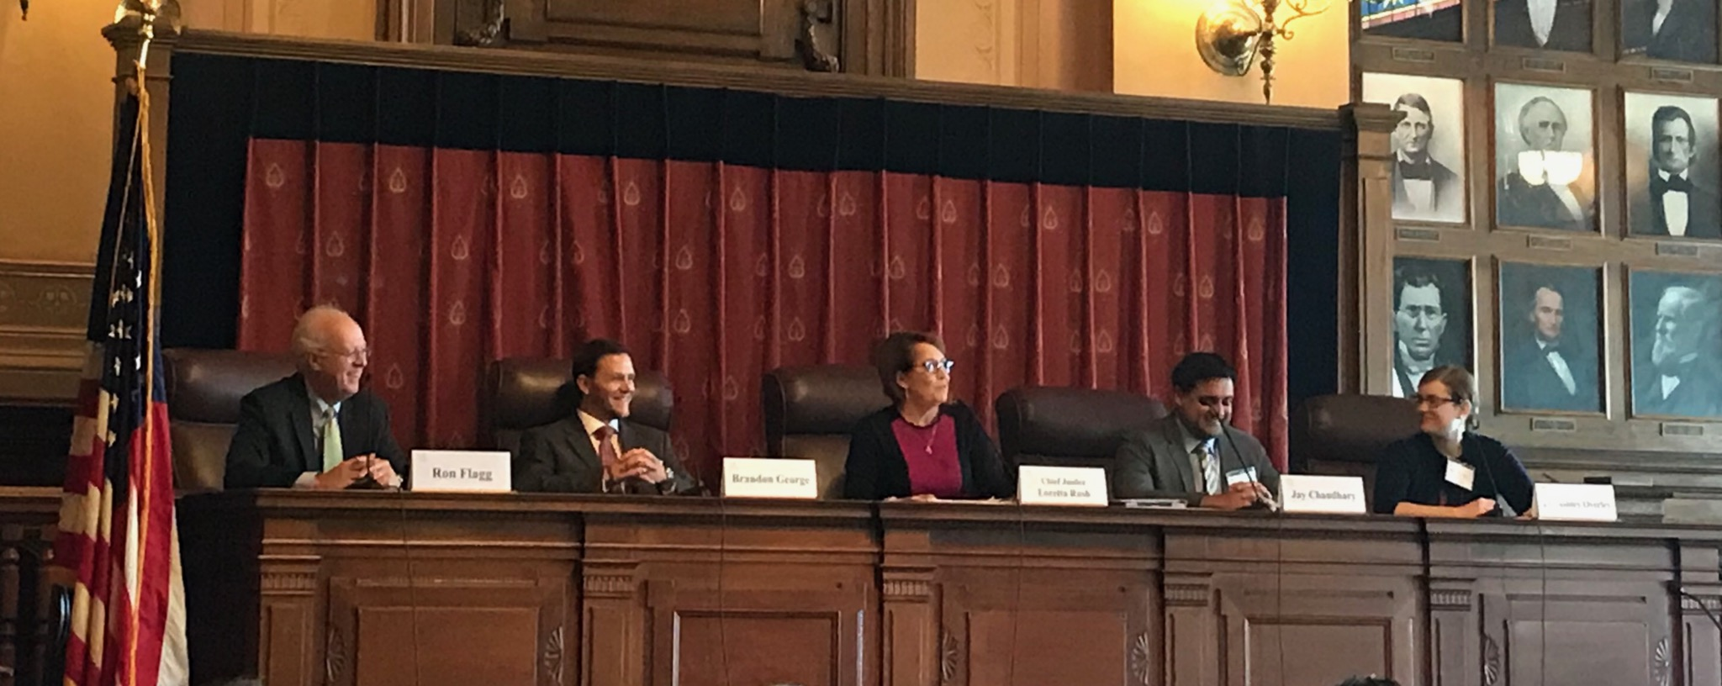

Slide 19
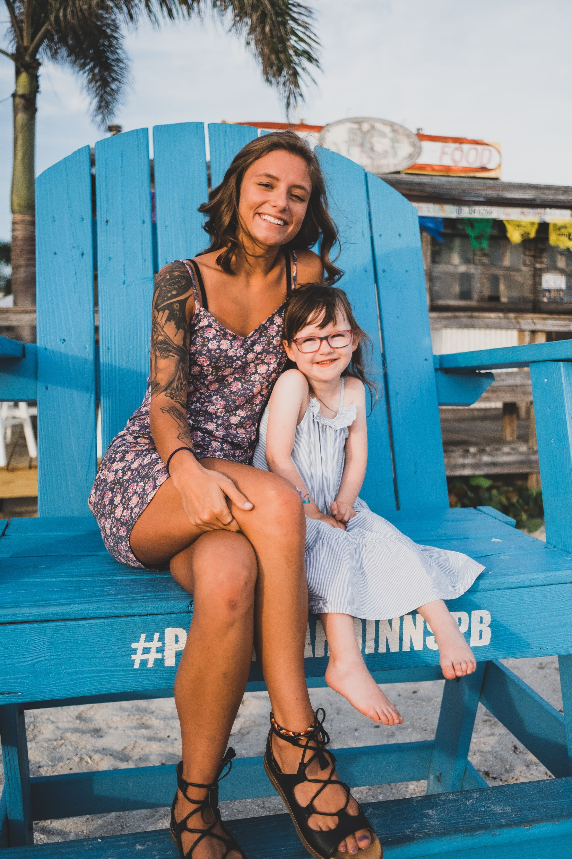

Slide 20
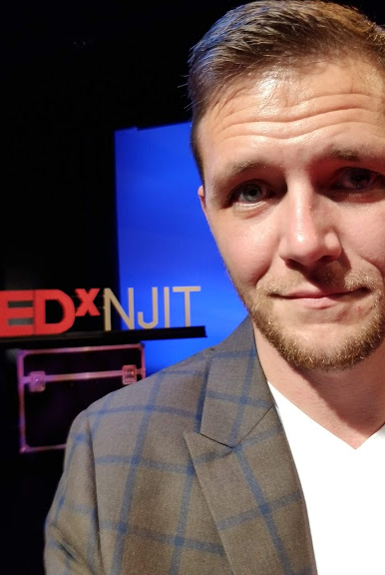
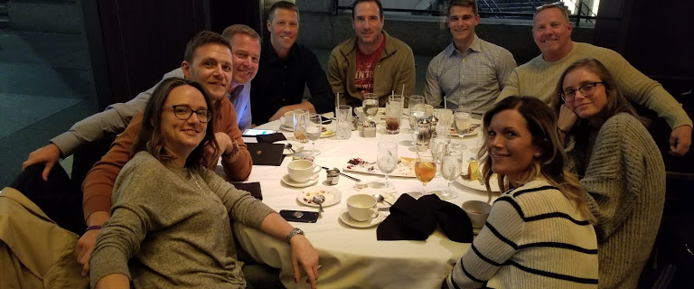
Family and Friends NY

Slide 21
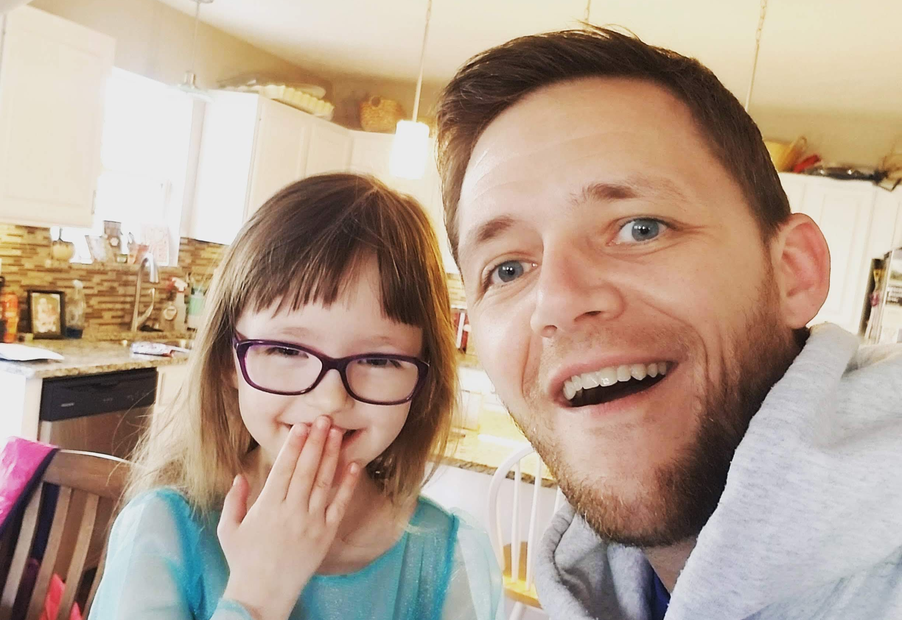

Slide 22
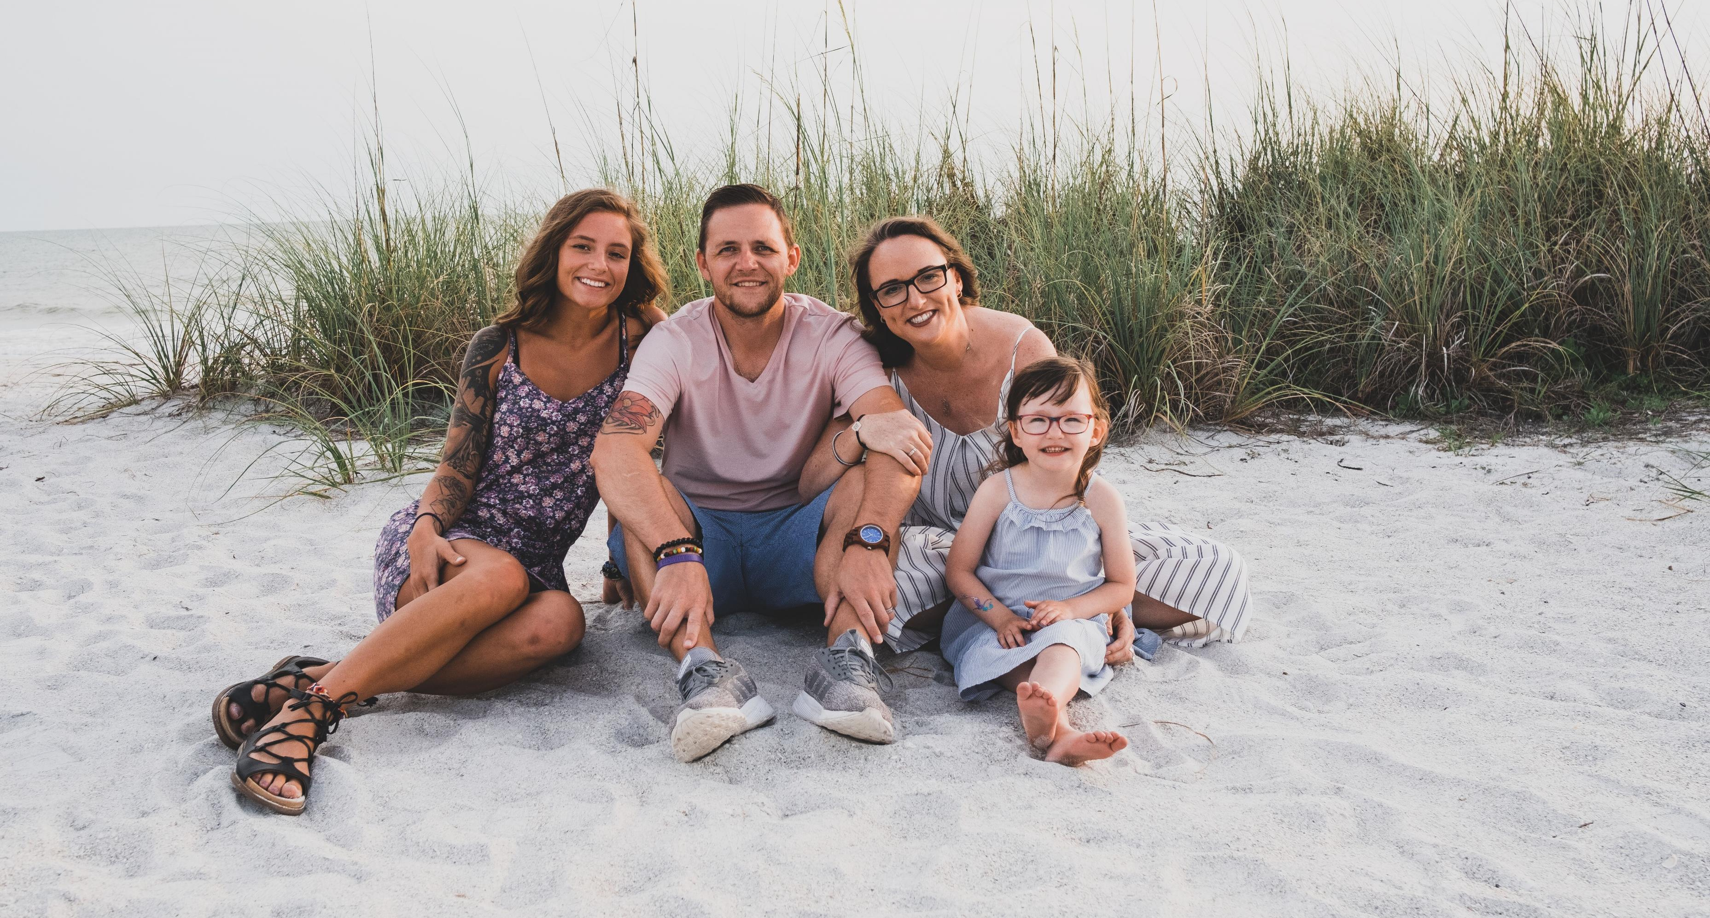

Slide 24
Practical Approaches
Building Recovery Ecosystems

Slide 25
Recovery Support Services
Recovery Community Organizations (RCOs)
Recovery Community Centers (RCCs)
Recovery Residences

Slide 26
What is Peer Recovery Support?

Slide 27
Indiana Association of Peer Recovery Support Services
IAPRSS.ORG

Slide 28
Recovery Support Services
Recovery Community Organizations (RCOs)
Recovery Community Centers (RCCs)
Recovery Residences

Slide 29
Recovery Support Services
Recovery Community Organizations (RCOs)
Recovery Community Centers (RCCs)
Recovery Residences

Slide 30
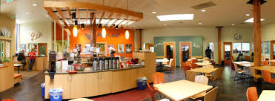

Slide 31
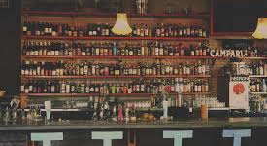
Sober Bars

Slide 32
Recovery Support Services
Recovery Community Organizations (RCOs)
Recovery Community Centers (RCCs)
Recovery Residences

Slide 33
www.indianarecoverynetwork.org

Slide 34
IRN: Health

Slide 35
Projects
Civil Legal Aid
Tedx Talk: Junkie Human Revolution
White House
Faces and Voices of Recovery
Bureau of Justice Assistance
National Judicial Opioid Task Force
SAMHSA: Opioid Response Network
Governor Holcomb’s Office
Indiana State Health Department
Indiana Supreme Court
Division of Mental Health and Addiction
Indiana Recovery Council: Do you speak stigma? Stigmaneverhelps.com
IN State Museum: FIX Exhibit

Slide 36
Legal Services
Corporation
Civil Legal Aid
Licenses
Debt
Housing
Expungements
Louisville, D.C., Detroit, Nashville, Chicago, Indianapolis, San Francisco

Slide 37
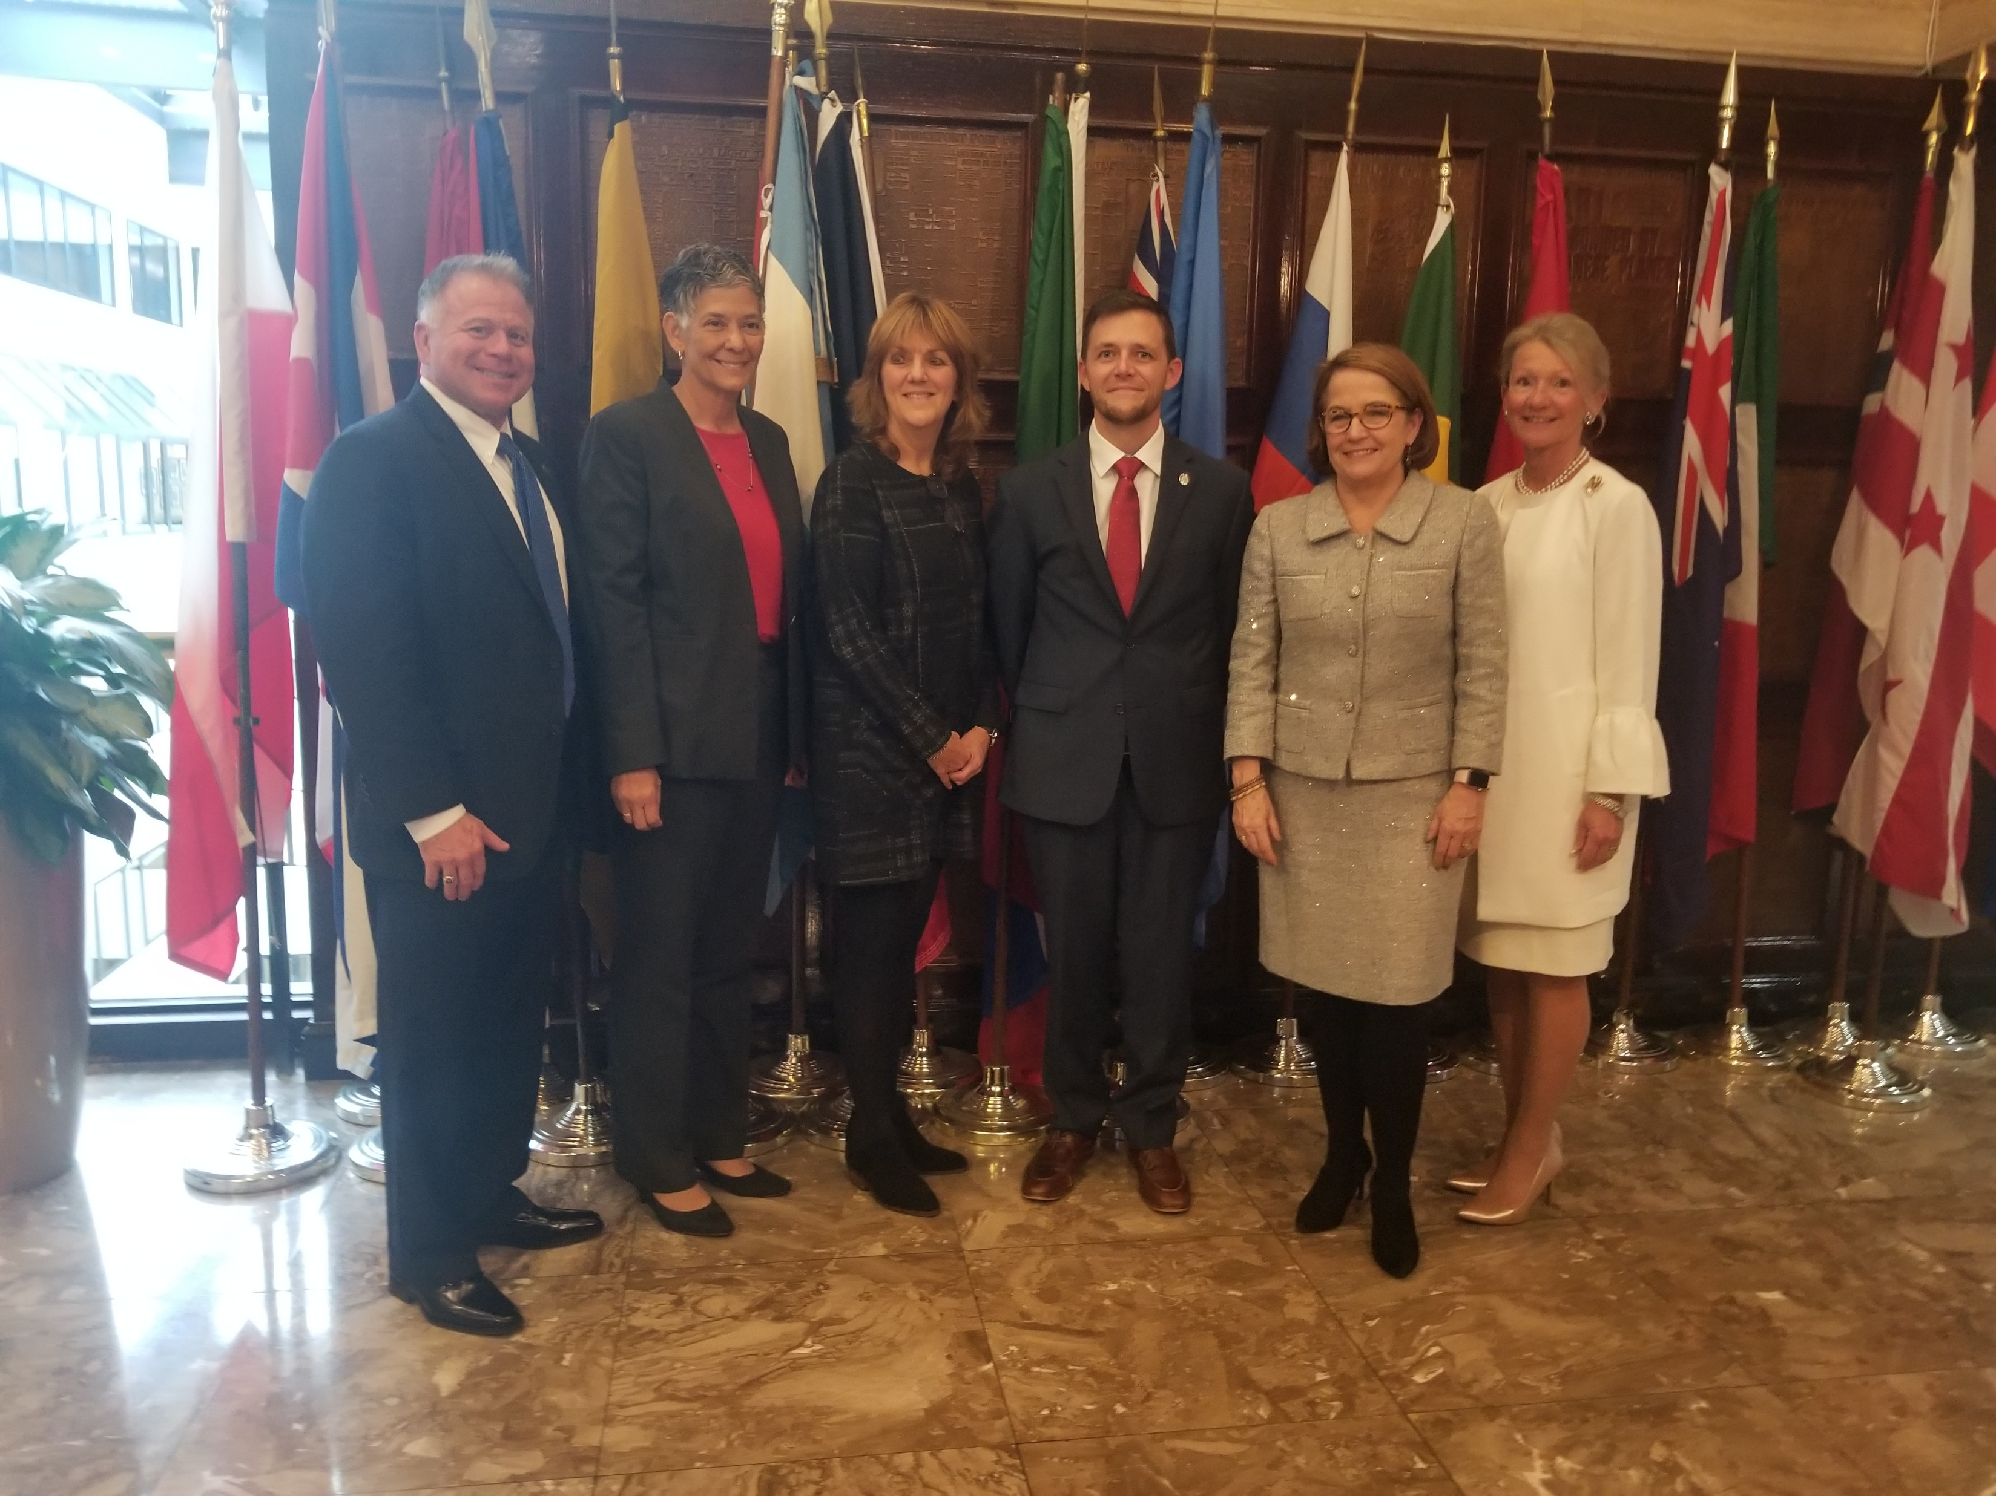
National Judicial Opioid Task Force
NCSC.ORG

Slide 38
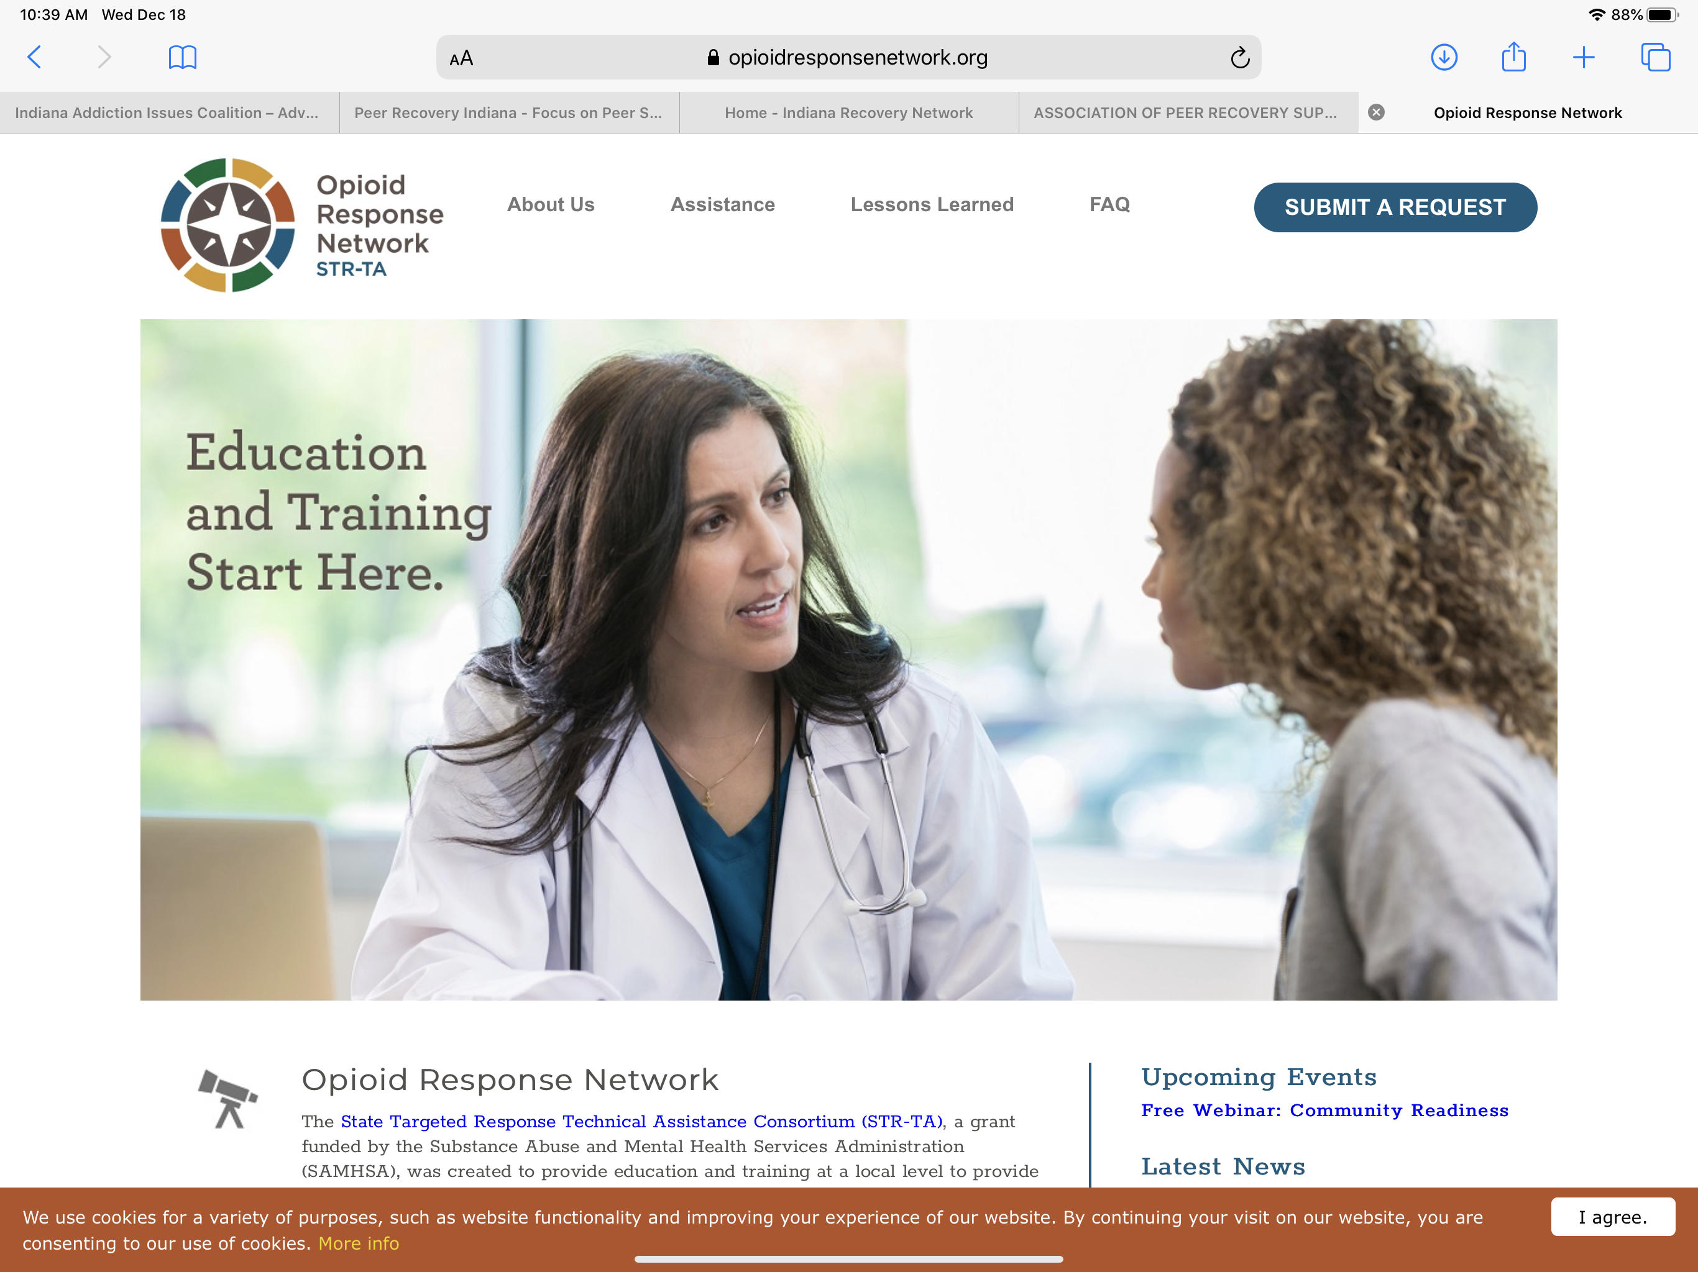
Opioid Response Network
OpioidResponseNetwork.org

Slide 39
Indiana Recovery Council: Do you Speak Stigma?

Slide 40
Indiana State Museum

Slide 41
Questions
Brandon George
Director
Indiana Addiction Issues Coalition
bgeorge@mhai.net
www.recoveryindiana.org
www.indianarecoverynetwork.org
www.iaprss.org

Slide 42
Questions?
Jodi Miller
Heather Rodriguez
Justin Beattey
Deputy Director
Indiana Addiction Issues Coalition
Jmiller@mhai.net
Manager, Peer Supports
Indiana Addiction Issues Coalition
jbeattey@mhai.net
Manager, Recovery Community Development
Indiana Addiction Issues Coalition
hrodriguez@mhai.net

