Slide 1
Arkansas Opidemic

Slide 3
…Our Economy
$115 billion
Cost of prescription opioid dependence, abuse, and overdose in the United
States in 2017

Slide 7
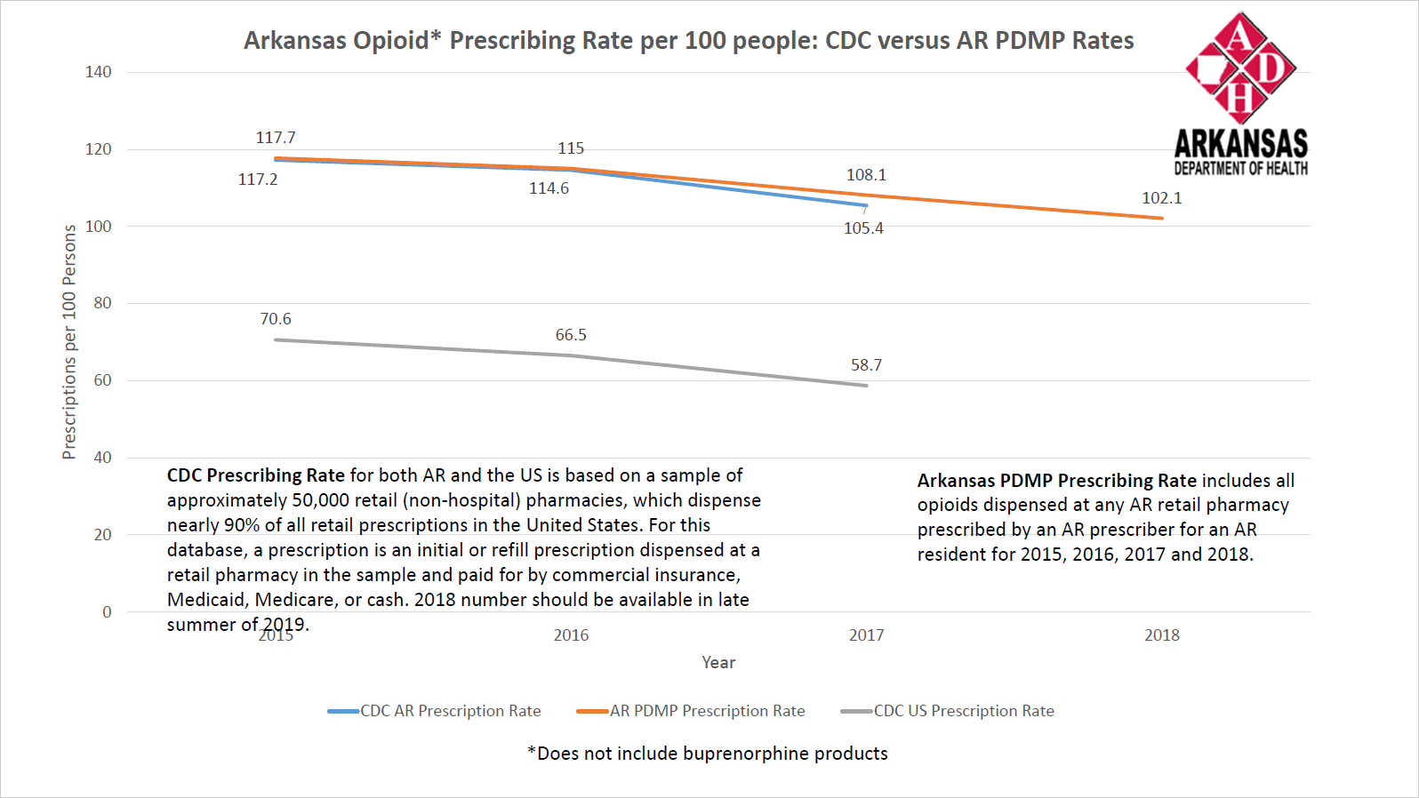
Notes:
All drug poisoning (overdose) deaths include unintentional (accidental), intentional (suicide or homicide), and undetermined intent. Of the deaths that specify a drug involved, the most commonly mentioned is a class of prescription painkillers called opioid analgesics.
For several years now, there have been more deaths involving opioid analgesics than heroin or cocaine combined. AND these figures are likely underestimates because death certificates do not always specify the drugs involved.

Slide 8
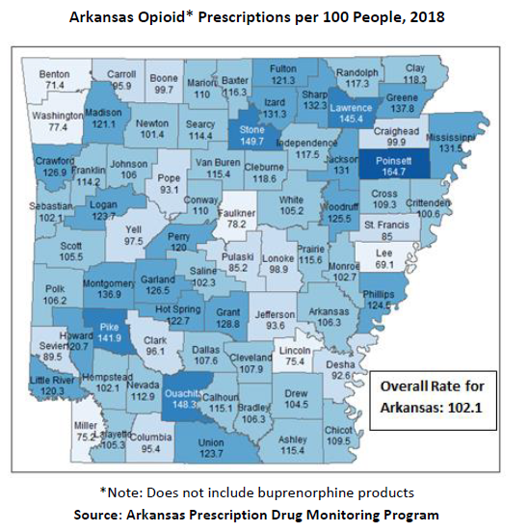

Slide 9
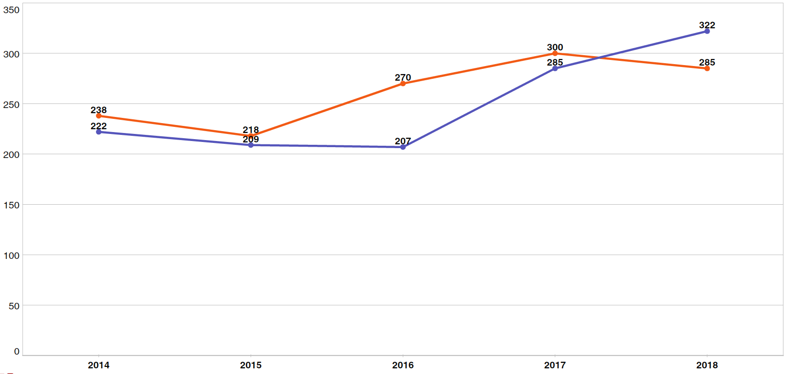
Autopsies Conducted 2014 – 2018
Homicides vs. Drug Overdoses
Homicides
Drug Overdoses

Slide 10
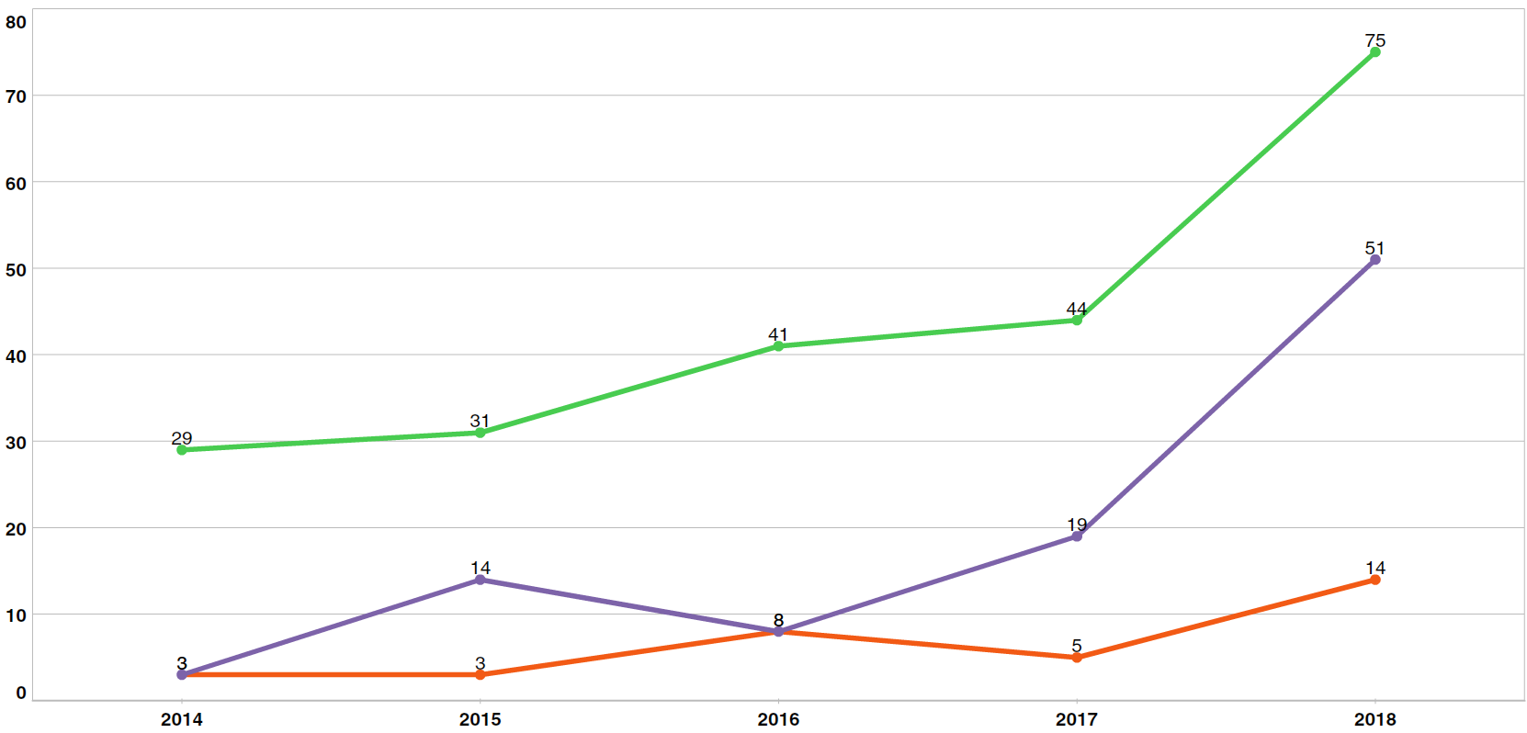
Autopsies Conducted 2014 – 2018
Drug Overdose Trends
Heroin
Fentanyl
Methamphetamine

Slide 11
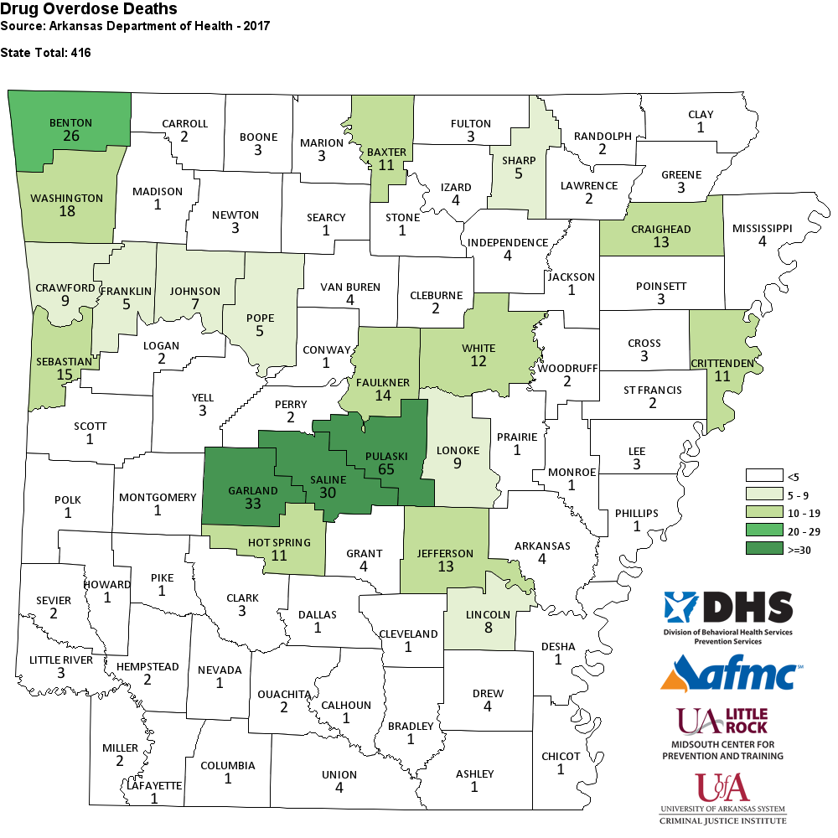
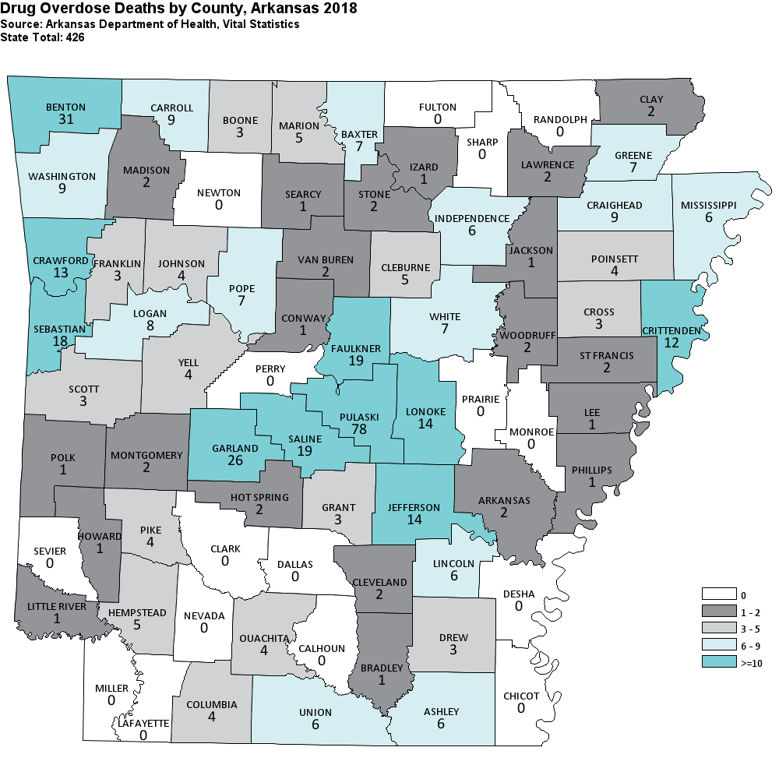

Slide 13
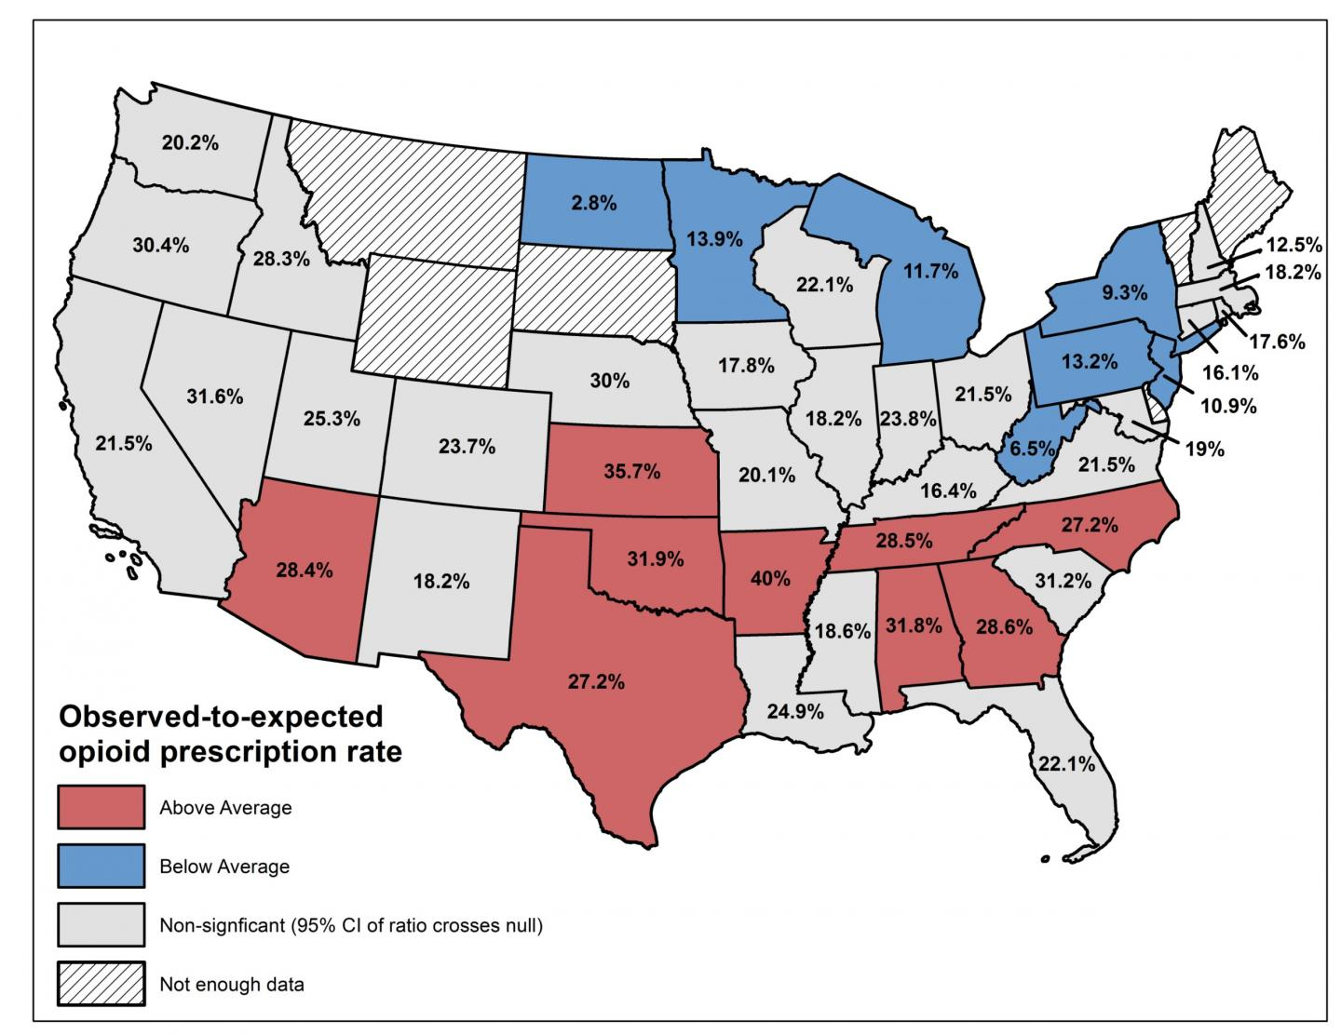
State-Level Variation of ED Opioid Prescribing Rates for Ankle Sprain
https://www.eurekalert.org/multimedia/pub/176336.php?from=400896

Slide 14
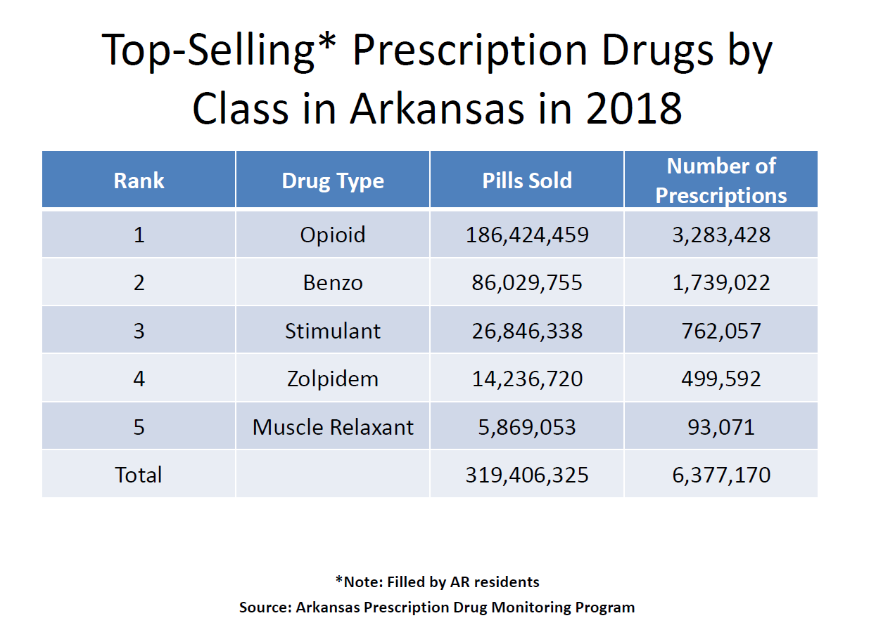

Slide 16
Prescription Drugs
The United States make ups about 5% of the world’s population, but uses 40% of the pharmaceuticals produced, and 99% of all Hydrocodone products manufactured in the WORLD.

Slide 17
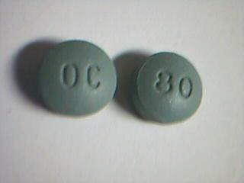
Circle of Addiction
Hydrocodone
Heroin
Oxycodone
OxyContin
Notes:
17

Slide 18
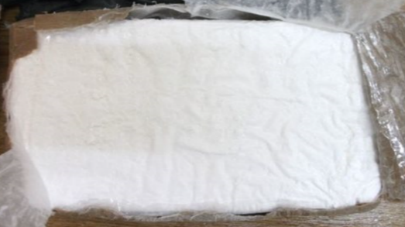
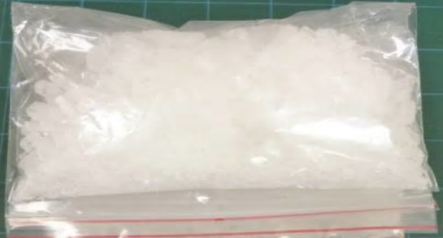
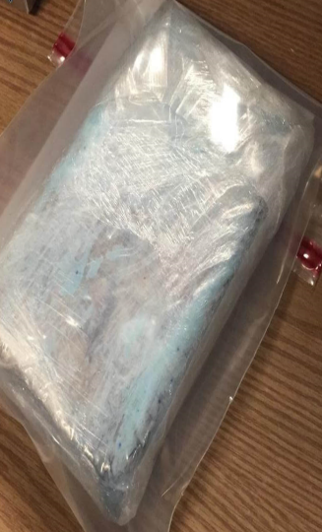
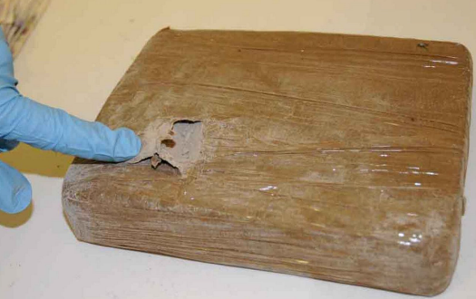
The Price of Illicit Drugs
The price of drugs will vary depending on the supply, demand and location.
A Kilo of Cocaine
$20,000-$46,000
A Kilo of Meth
$10,000-$90,000
A Kilo of Heroin
$32,000-$75,000
A Kilo of Fentanyl
$3,500
Source: Open Online Internet Sources in the U.S. on 2-14-18

Slide 21
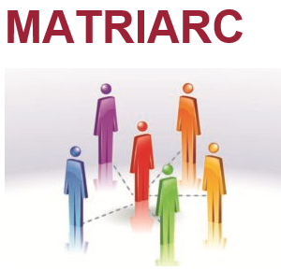
MATRIARC (Medication Assisted Treatment Recovery Initiative for Arkansas Rural Communities) is a partnership with the Psychiatric Research Institute and the Arkansas Department of Human Services designed to expand evidence-based treatment for opioid use disorders.

Slide 22
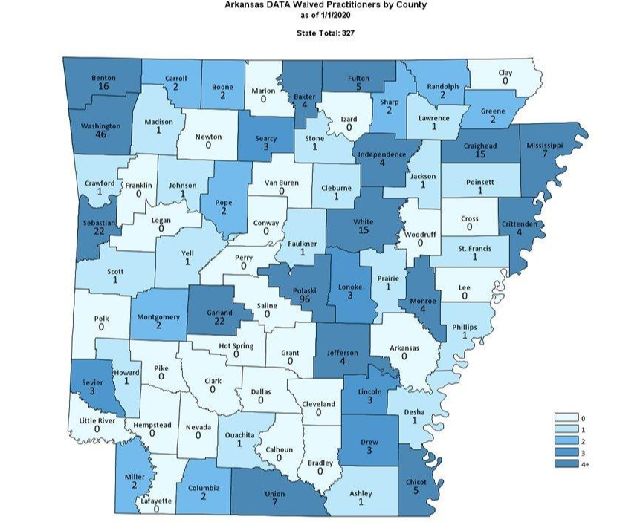

Slide 24
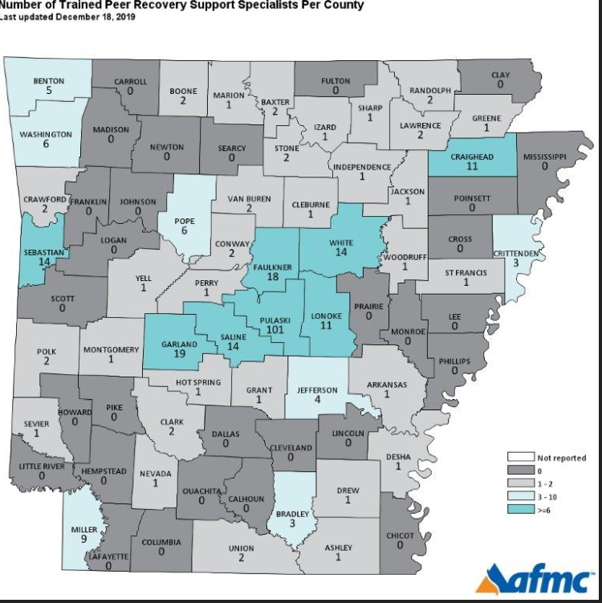

Slide 25
APART
Arkansas Peers Achieving Recovery Together.
Mission - To expand recovery services for Substance Use throughout the State of Arkansas. To develop, implement and evaluate statewide efforts to broaden recovery and awareness.
Vision - To be the premiere stigma free, recovery-oriented state dedicated to changing and saving lives.
Purpose - To place peer support in positions to be most effective in helping others achieve recovery from Substance Use

Slide 26
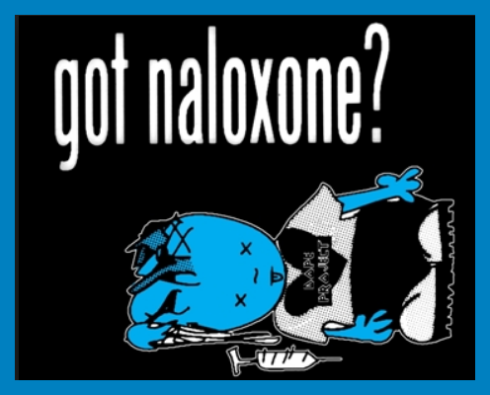

Slide 27
The Solution: 20-13-1604 Opioid antagonist – Immunity-ACT 1222 of 2015
(a) A healthcare professional acting in good faith may directly or by standing order prescribe and dispense an opioid antagonist to: (5) A first responder; (6) A law enforcement officer or agency; or (b) A person acting in good faith who reasonably believes that another person is experiencing an opioid-related drug overdose may administer an opioid antagonist that was prescribed and dispensed under section (a) of this section. (c) The following individuals are immune from civil liability, criminal liability, or professional sanctions for administering, prescribing, or dispensing an opioid antagonist under this section: (3) A person other than a healthcare professional who administers an opioid antagonist under subsection (b) of this section.

Slide 28
Act 284 of 2017 allows easier access to naloxone:
“Pursuant to a statewide protocol, a pharmacist may initiate therapy and administer or dispense, or both, Naloxone”

Slide 29
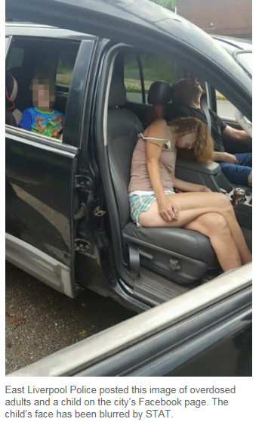
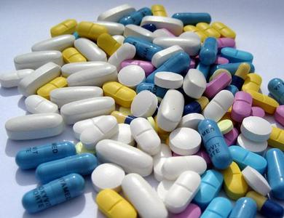
Identifying an Opioid Overdose

Slide 30
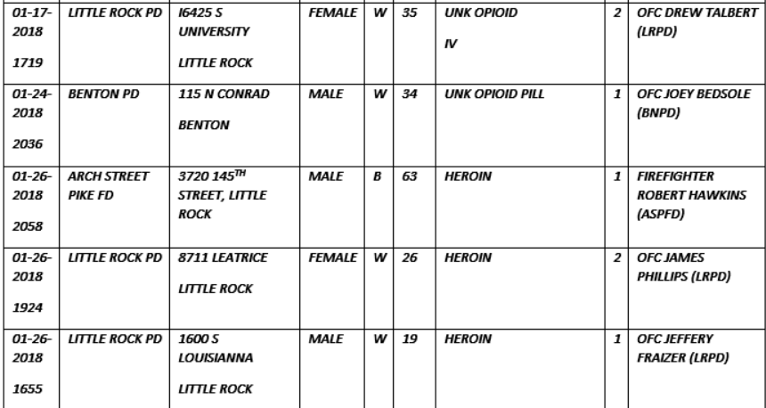

Slide 31
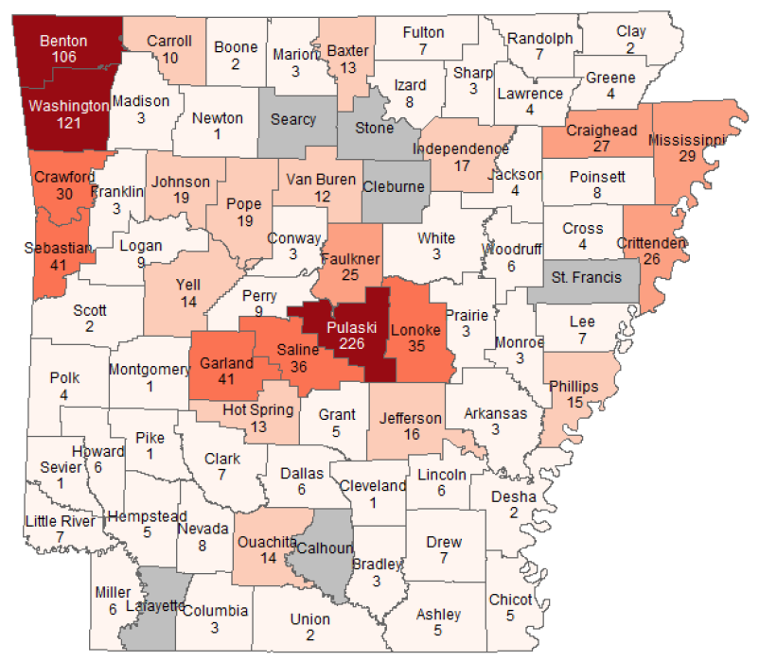
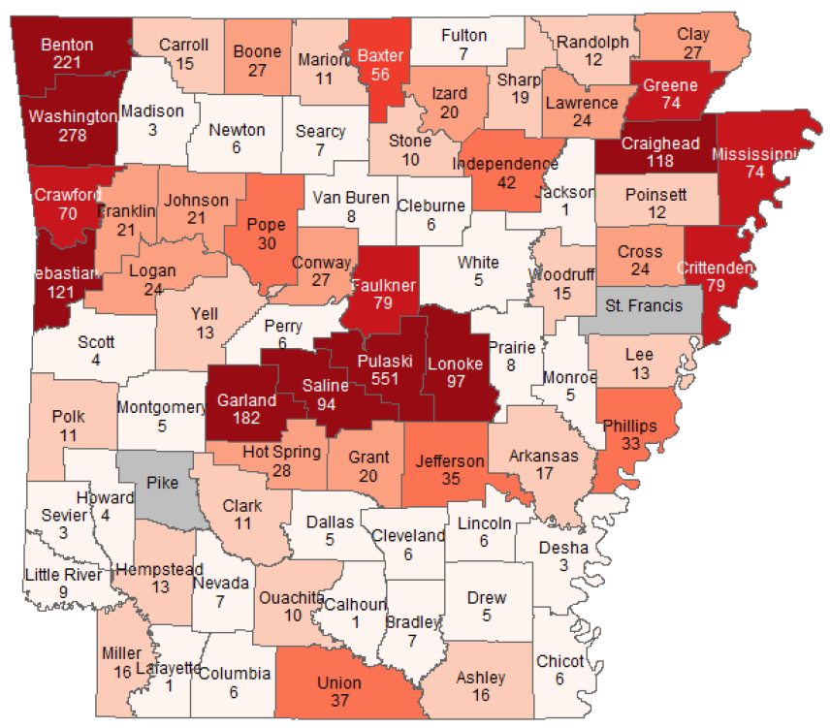
Arkansas EMS 2017
Arkansas EMS 2018

Slide 32
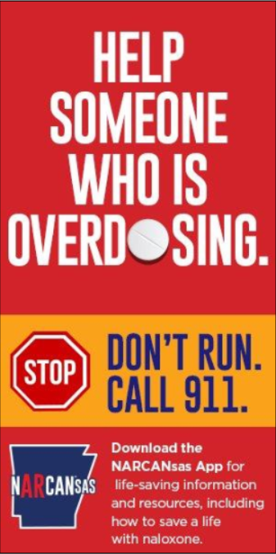

Slide 33
JOSHUA ASHLEY-PAULEY ACT ACT 1114 OF 2015
A person shall not be arrested, charged, or prosecuted for possession of a controlled substance if the evidence results solely from seeking medical assistance if:
The person in good faith seeks medical assistance for another person who is experiencing a drug overdose; or
A person who is experiencing a drug overdose and in good faith seeks medical assistance for himself or herself.

Slide 34
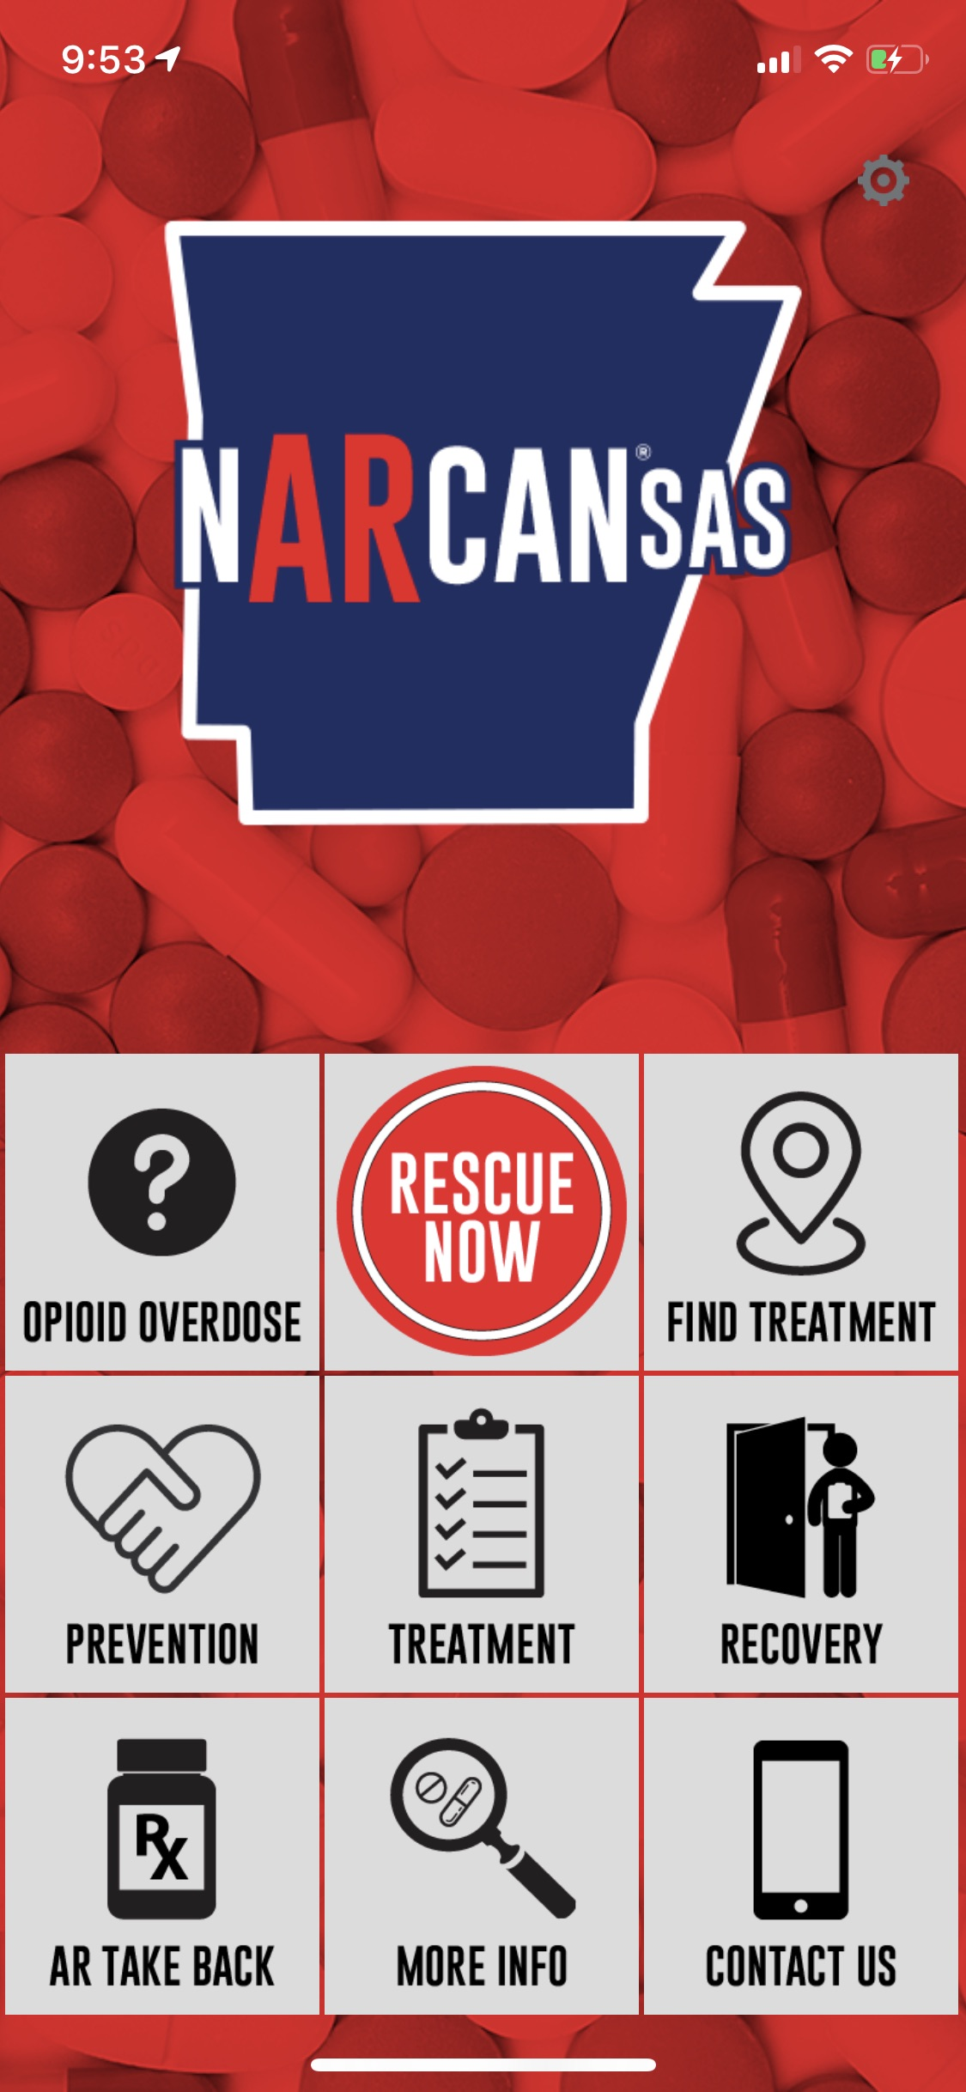

Slide 35
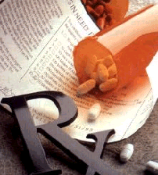
Quick Fact
Prescription drug abuse has always been around. It is estimated that more than 4 billion prescriptions are written annually in the US. Approximately 40% of them go unused (outside of a hospital setting).

Slide 36
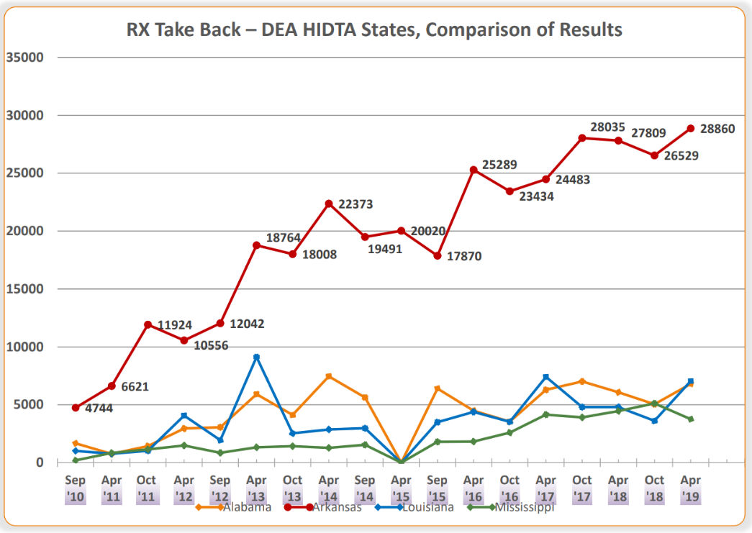
Drug Take Back – Quantity in Pounds?

Slide 37
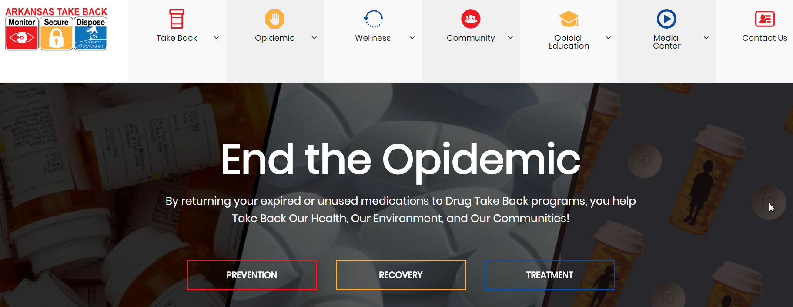
www.artakeback.org
Updated Website with New Info

Slide 39
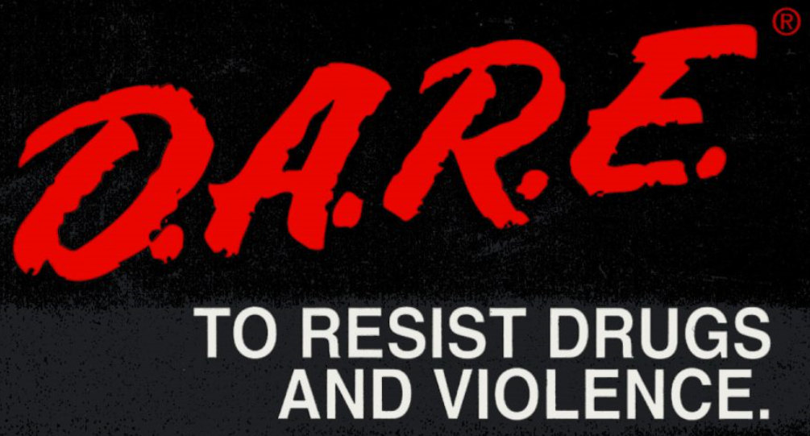

Slide 41
Advanced Overdose Investigation

Slide 42
Thank you!
Kirk Lane
Arkansas Drug Director
1-501-317-9042
kirk.lane@asp.arkansas.gov
www.artakeback.org

Slide 43
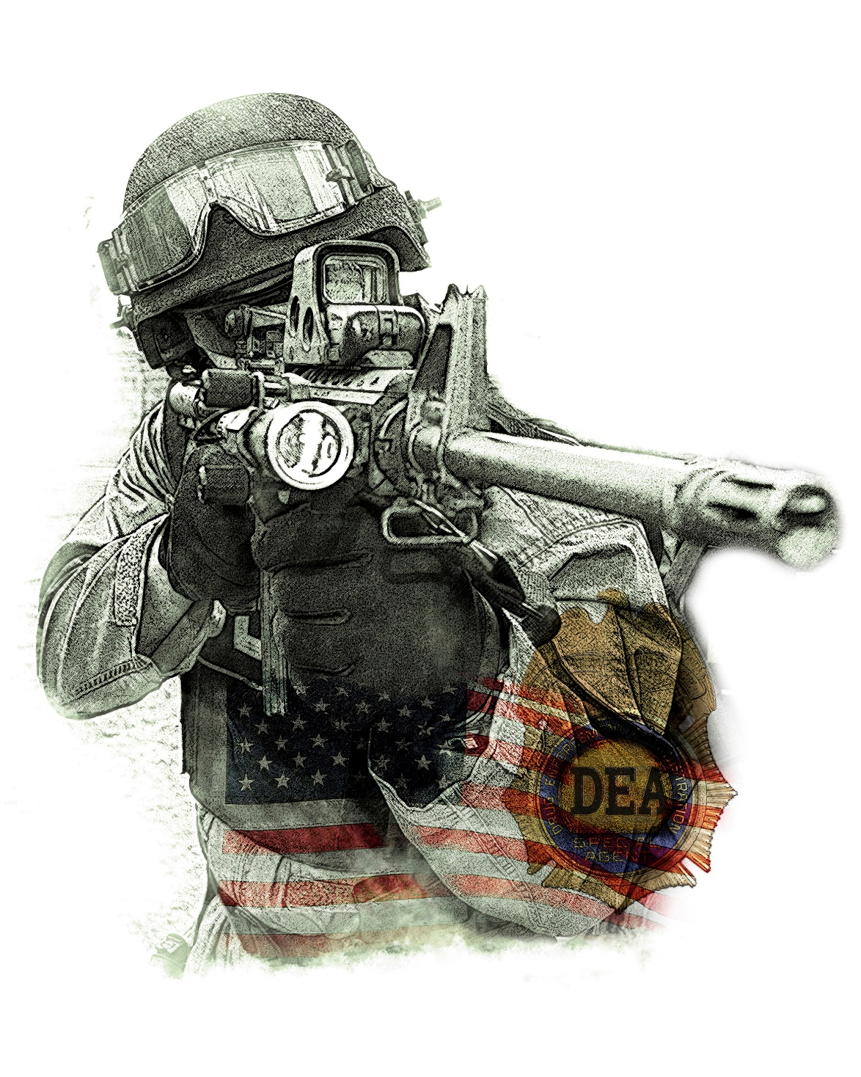
LITTLE ROCK DISTRICT OFFICE: 501-217-6500
GS TOM FISHER: 501-804-3508
thomas.m.fisher@usdoj.gov
ASAC JUSTIN KING: 571-230-5695
justin.c.king@usdoj.gov

